Slide 1

Emotion Classifier using nanogpt
Presented by:
Aryan Shrestha
Roshan Kandel

Slide 2
Introduction
This project adapts NanoGPT, a lightweight GPT implementation, modified to classify emotions in text data.
This project will investigate how smaller models, such as NanoGPT, can be efficiently trained for multi-class emotion classification without the need for massive computational infrastructure.

Slide 3
Related work
Transformers (Vaswani et al., 2017) introduced self-attention for sequence modeling
GPT models (GPT-2, GPT-3) excel in text generation but are computationally intensive
nanoGPT (Karpathy, 2023) offers a lightweight, scalable version of GPT for fine-tuning

Slide 4
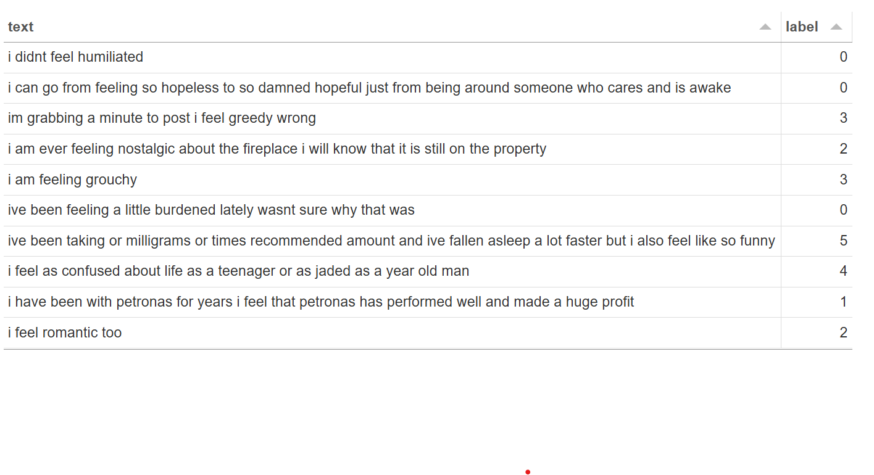
Dataset Description
The dataset used is Twitter Emotion Classification available in Kaggle which contains thousands of text sequences extracted from Twitter (X).
Each text has a corresponding label which includes six emotion categories: sadness (0), joy (1), love (2), anger (3), fear (4), and surprise (5).
There are 16,000 samples in the training dataset and 2000 samples in the validation and test dataset respectively.

Slide 5
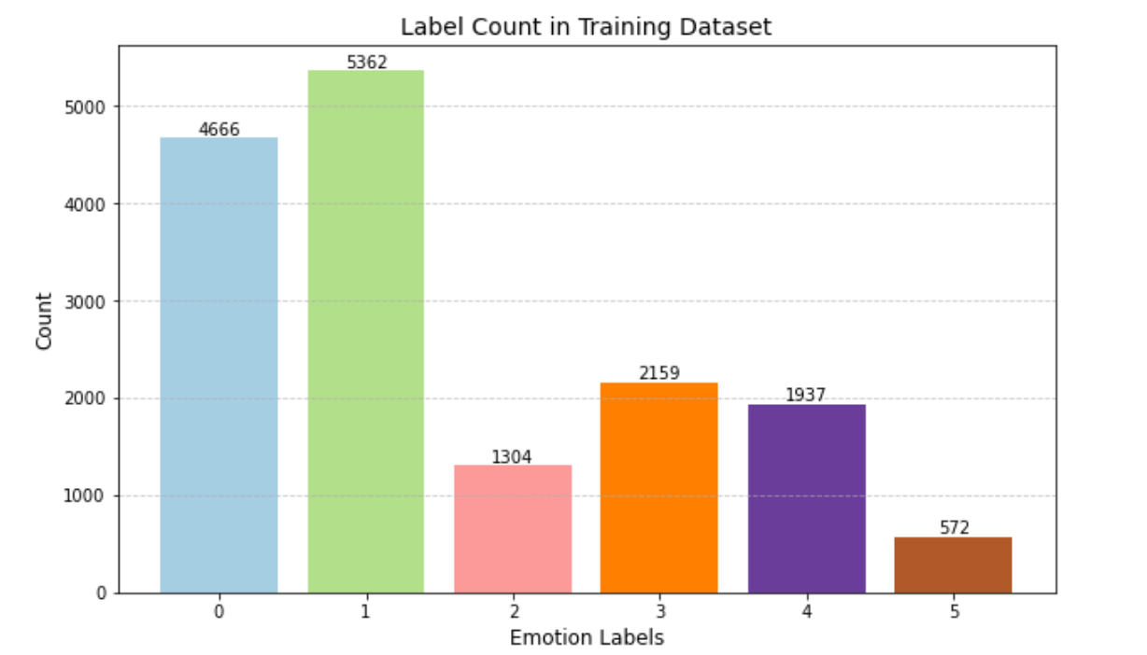
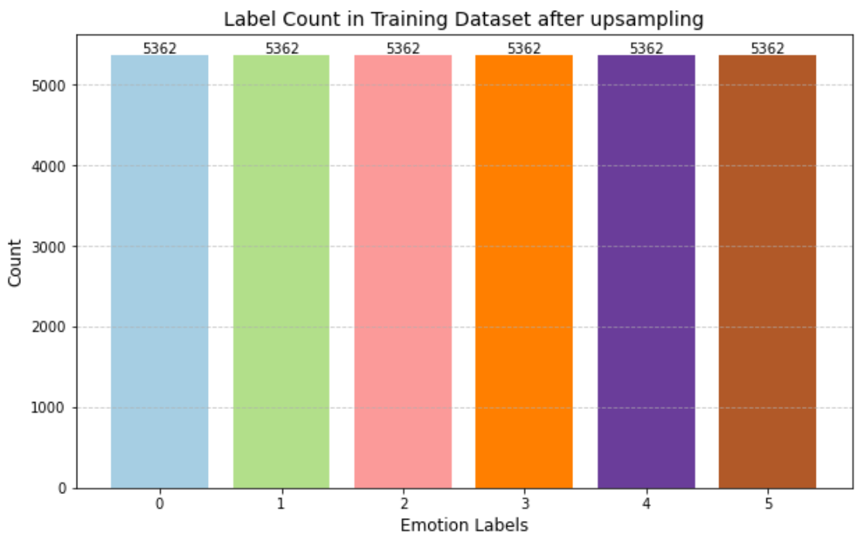
Class imbalance problem
The class imbalance problem is addressed through oversampling.

Slide 6
Dataset preprocessing
Tokenization: The text was tokenized using GPT-2 tokenizer from Hugging Face tiktoken library, truncating at 128 tokens.
Padding: The tokenized sequences was padded for uniform batch processing during training.
Saved Format: The preprocessed data are stored as .npz files for quick loading.

Slide 7
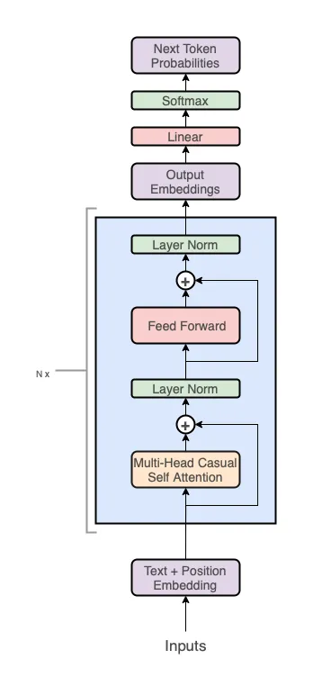
Nanogpt model architecture
The architecture is Transformer-based GPT model with multiple layers (N blocks) which includes following core components:
Multi-Head Causal Self-Attention: Captures dependencies between tokens, ensuring only previous tokens influence predictions
Layer Normalization: Stabilizes training and accelerates convergence by normalizing inputs
Feed Forward Network: Processes intermediate representations to enhance model capacity
Residual Connections: Enhance gradient flow across layers, helping with optimization

Slide 8
Modified architecture
The original model was made only for text inputs, so we had to modify the architecture slightly to accommodate both text and emotion labels.
Classification Head: Added a linear layer for emotion prediction across 6 classes
Weighted Cross-Entropy Loss: Handles class imbalance by assigning higher weights to minority classes

Slide 9
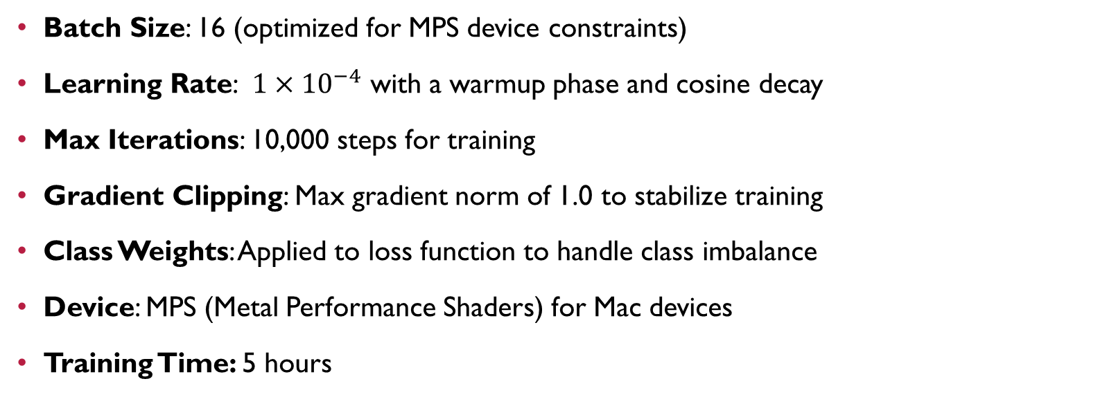
Training parameters
Batch Size: 16 (optimized for MPS device constraints)
Learning Rate: ${1×10}^{−4}$ with a warmup phase and cosine decay
Max Iterations: 10,000 steps for training
Gradient Clipping: Max gradient norm of 1.0 to stabilize training
Class Weights: Applied to loss function to handle class imbalance
Device: MPS (Metal Performance Shaders) for Mac devices
Training Time: 5 hours

Slide 10
Training Process
Batch Preparation: Generate padded and truncated sequences, converted into tensors
Forward Pass: Inputs processed through transformer blocks and classification head
Loss Calculation: Weighted cross-entropy loss handles class imbalance
Backward Pass: Gradients calculated and optimized using AdamW with gradient clipping
Learning Rate: Warmup phase followed by cosine decay for smooth training
Validation & Checkpointing: Evaluate periodically, save the best model based on validation loss

Slide 11
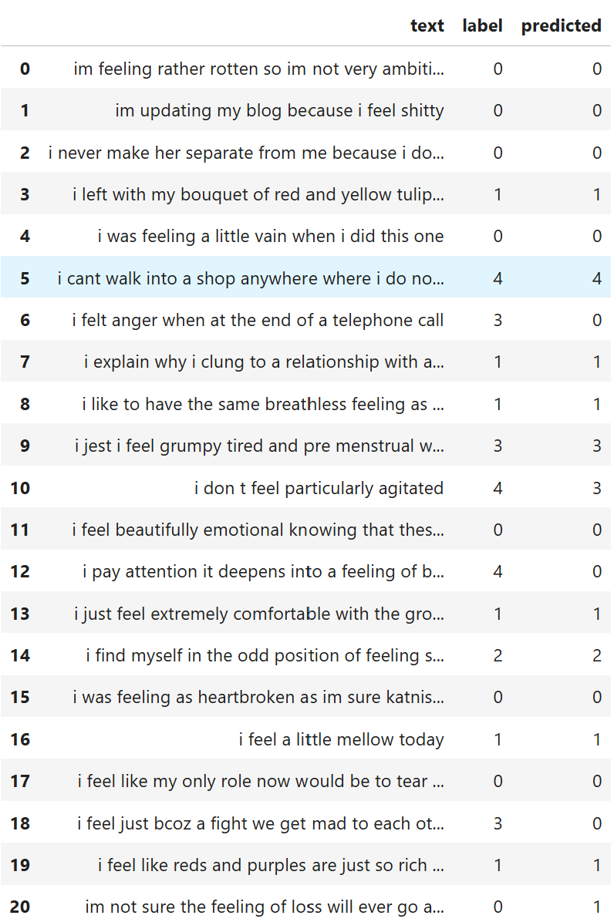
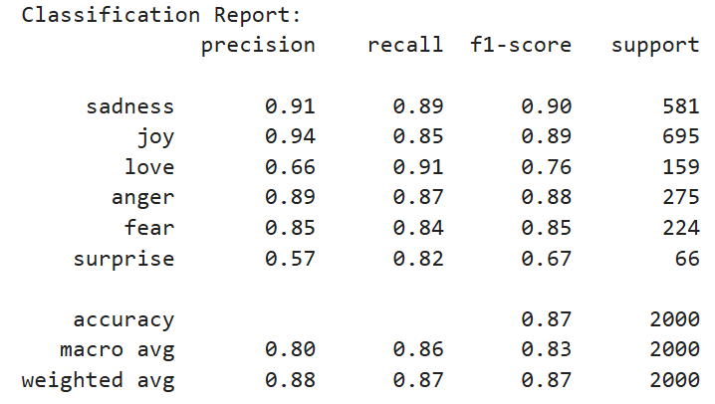
Evaluation
After training for 10,000 iterations, the model was able to successfully classify emotions on test dataset.
High for sadness and fear due to distinct patterns but low for love and surprise due to semantic overlap.

Slide 12
Evaluation
Short vs Long Sentences:
Separated test data by token length to analyze performance differences on short and long sentences
Evaluated the model on both types of sentences
Short sentences: Higher accuracy (0.87) for short sentences due to lower complexity.
Long sentences: Slightly lower performance (0.83) for long sentences due to increased contextual dependencies.

Slide 13
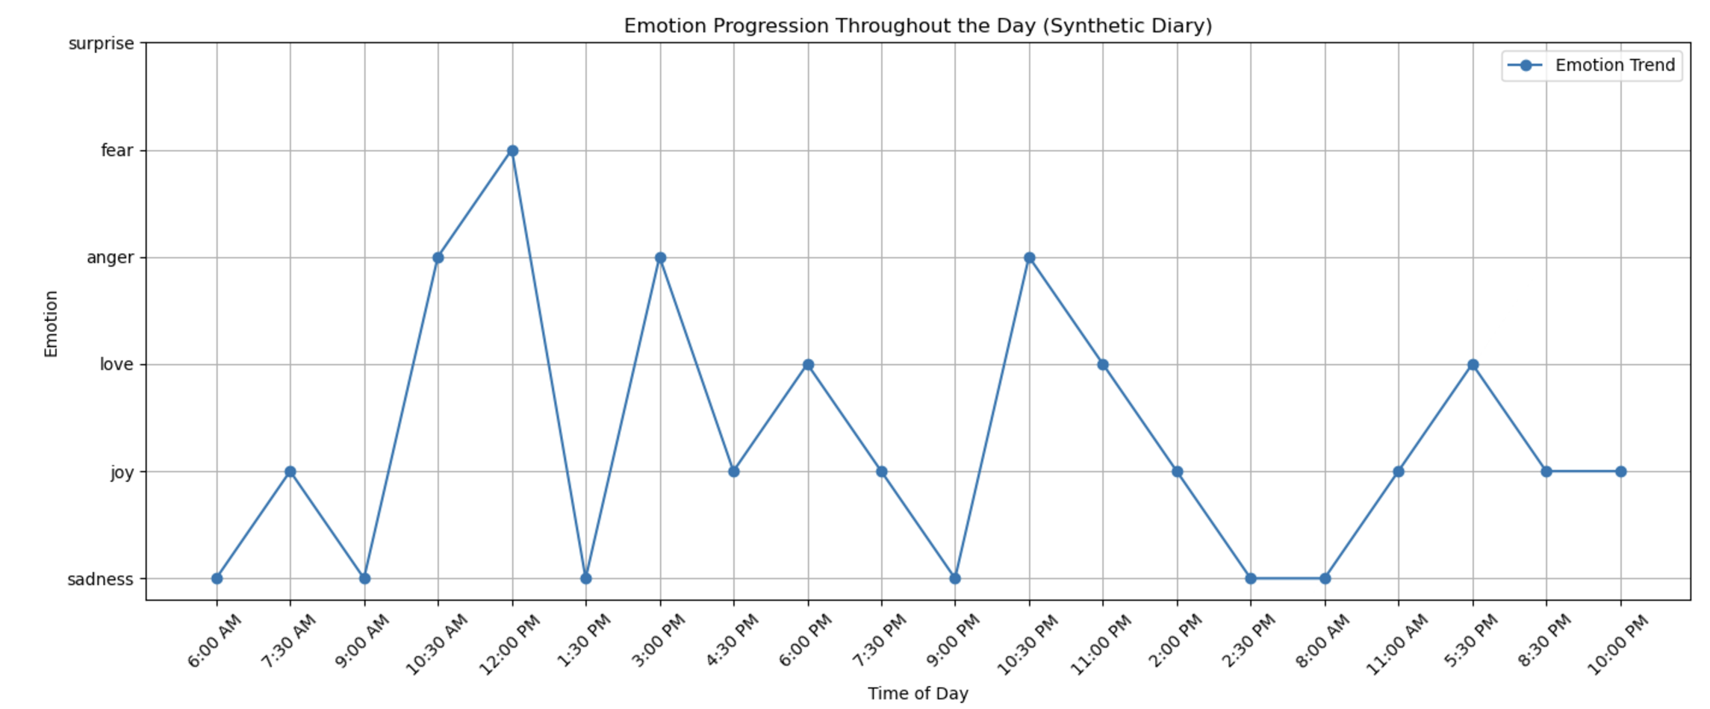
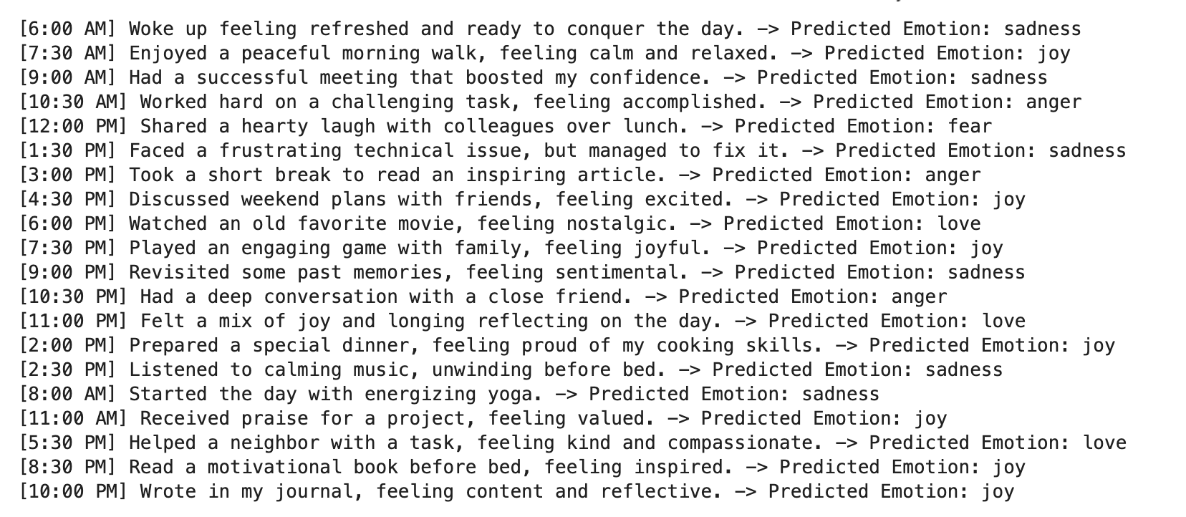
Evaluation
Diary Dataset
Created a synthetic diary dataset for testing and got 48% accuracy

Slide 14
Limitations
Despite class weights, rare emotions like "love" and "surprise" are harder to predict accurately
Performance drop on very long or highly ambiguous sentences
Increasing the iterations doesn’t improve model performance
Even with optimization, processing large datasets can strain resources

Slide 15
Conclusion
Successful Adaptation: GPT architecture modified effectively for emotion classification and achieved high accuracy
Robust Performance: Demonstrates reliable predictions with balanced data and optimized training
Scalable Framework: The model can be extended to other classification tasks with minimal changes
Less Computational Resources: Optimized for MPS backend, making it efficient for Mac devices with limited GPU power

Slide 16
Future Work
Address dataset imbalance through data augmentation
Optimize hyperparameters for improved performance
Experiment with deeper architectures or attention mechanisms like Transformer-XL
Incorporate hierarchical models for long sequences to avoid truncation losses
Develop interpretable attention maps to understand model predictions better

